Slide 1
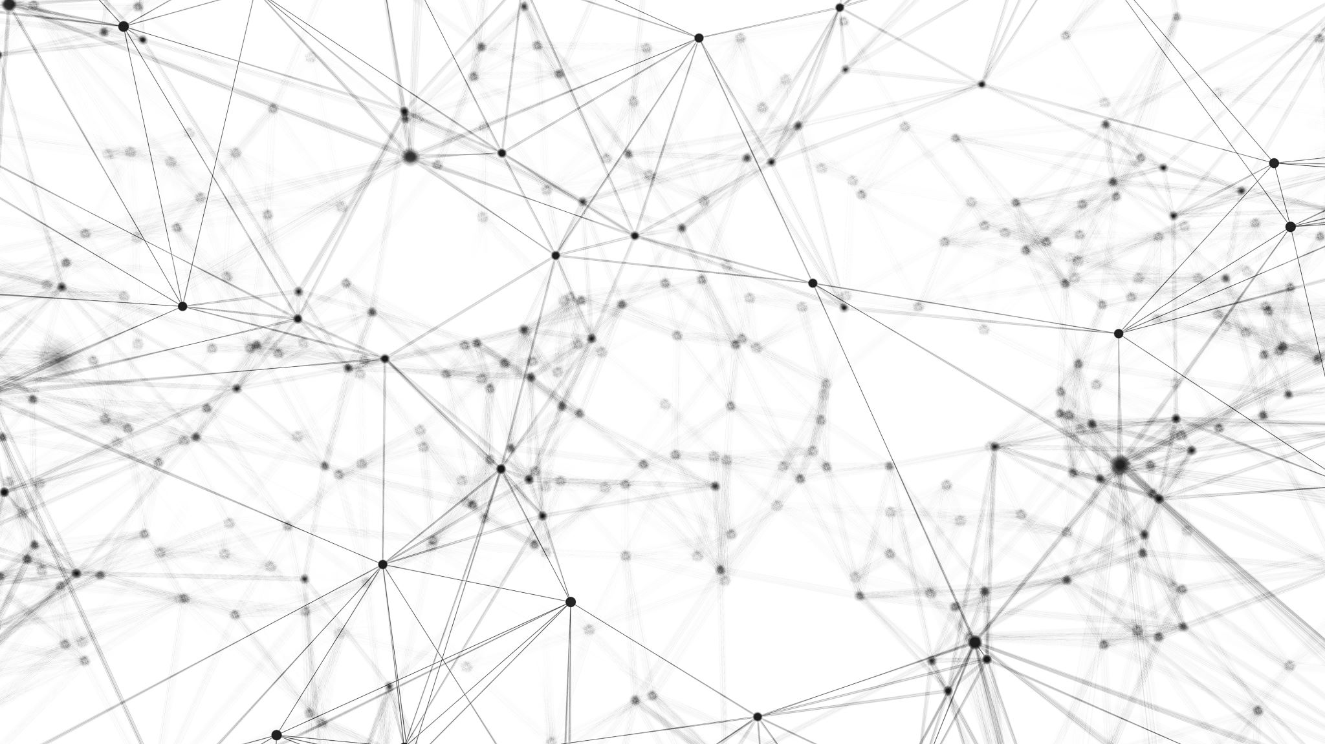
Mobile Application Development, Fall 2021 Layouts Parts 1 & 2

Slide 2
Today’s Agenda
Today’s Plan
Intro to the Box Object Model
Intro to Flex Box
The Position Property
Putting it All Together

Slide 3
Today’s Plan
So, by this point, we’ve actually have covered a lot of the major systems that go into a React Native application!

Slide 4
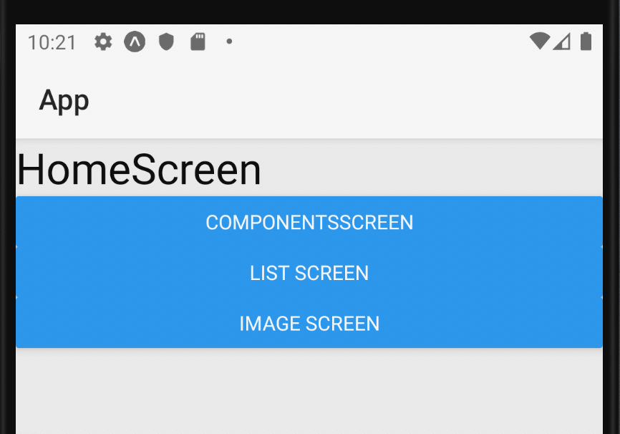
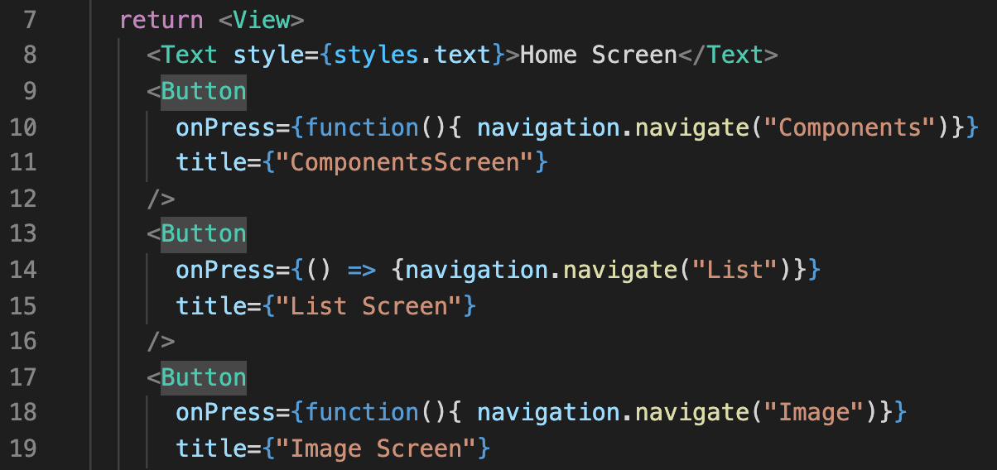
Today’s Plan
We know how to handle events, like the Button component’s onPress event!

Slide 5
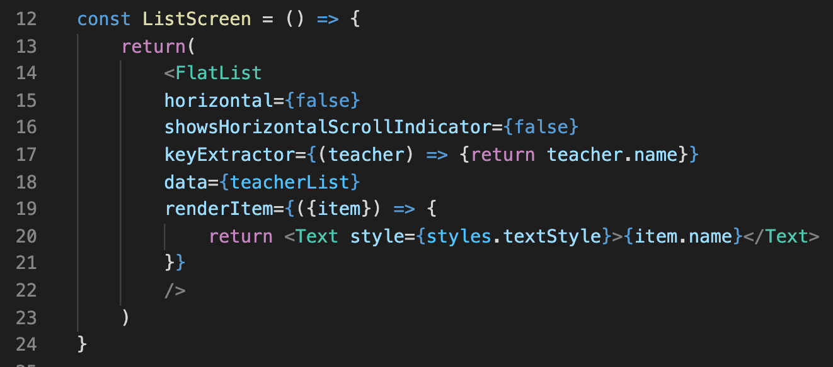
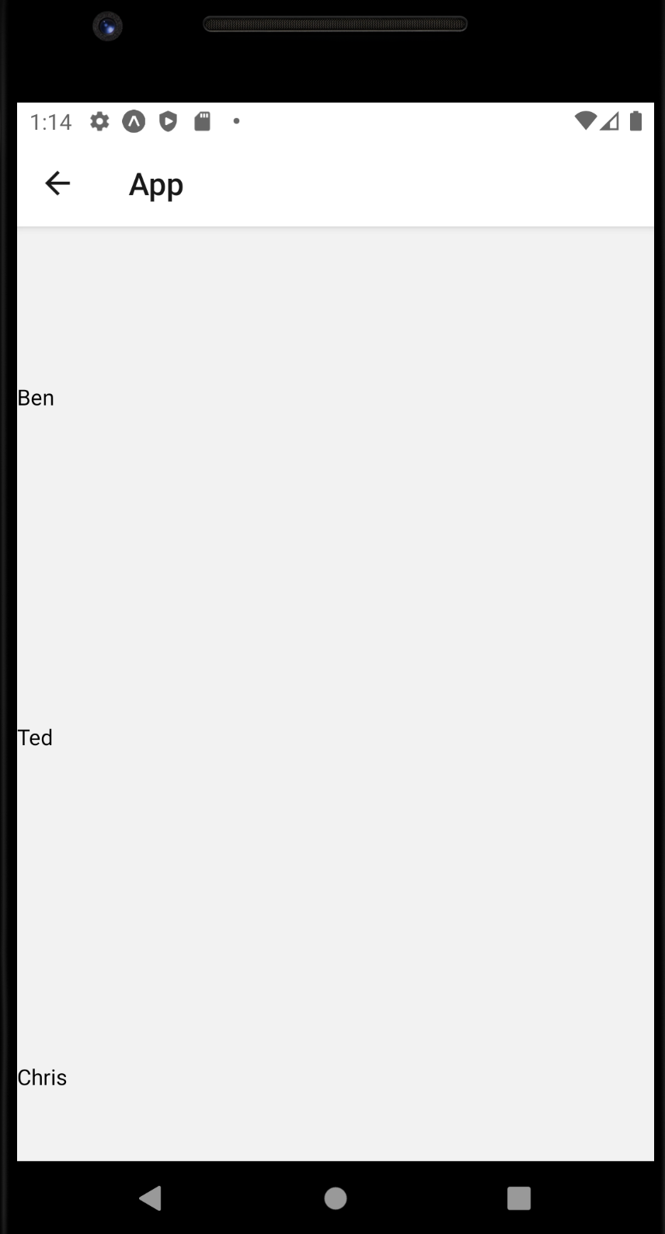
Today’s Plan
We’ve gotten lots of practice dealing with props!

Slide 6
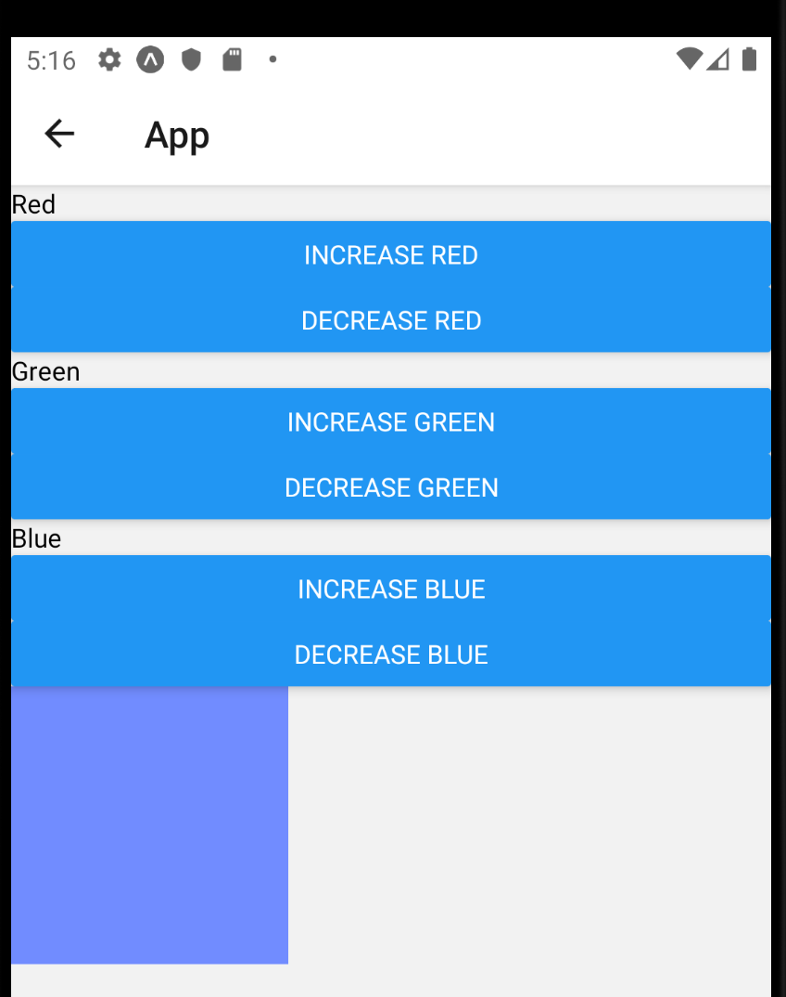
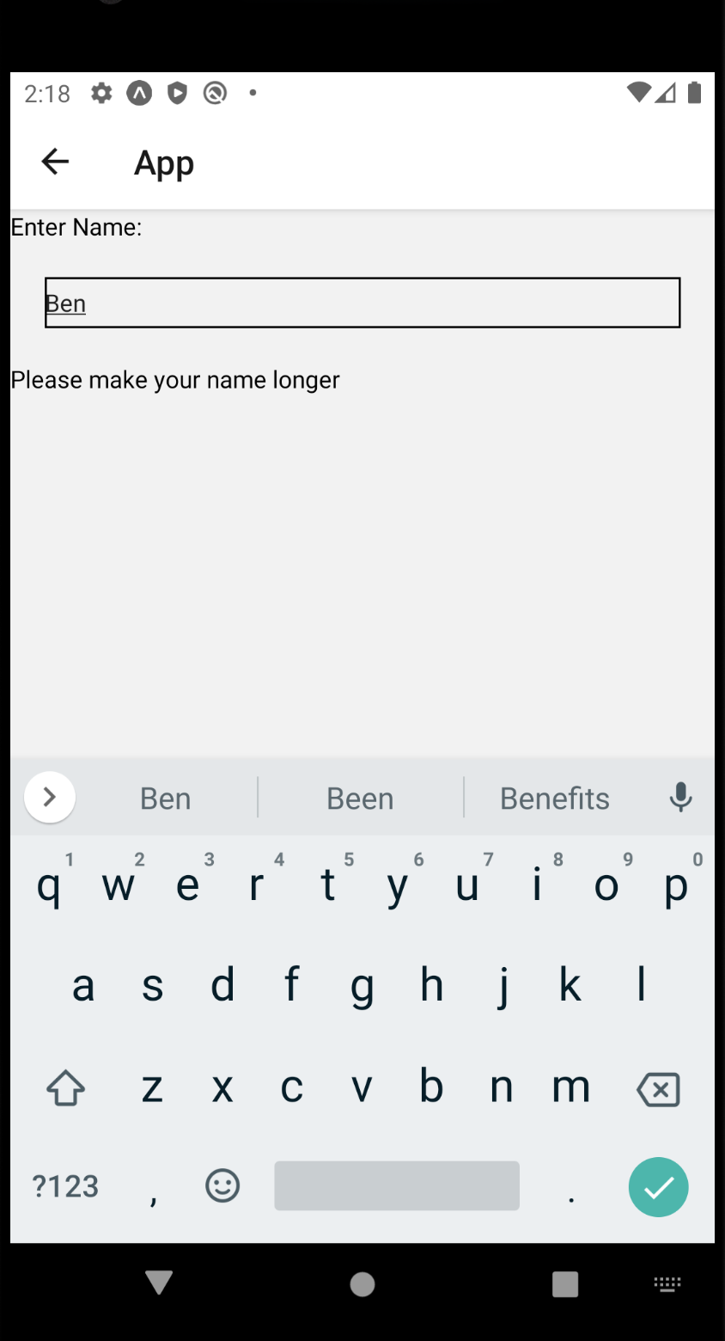
Today’s Plan
And now we’ve gotten up close and personal with working with state as well!

Slide 7
Today’s Plan
Now, we’re going to move on to another major topic: Layout!
By layout, we basically mean, learning new ways to style our apps, so that we can make them look really nice!

Slide 8
Today’s Plan
The first thing to know about layout in React Native, is that there are three different Layout Systems to choose from!
1.) Box Object Model
2.) Flex Box
3.) Position
You can mix and match them throughout your application.
E.g., one component might use Flex Box, another might use the Box Object Model.

Slide 9
Today’s Plan
OK, that’s all well and good, but what are they?
WELL, we’ll go over them in more detail soon, but just to give you a high level sense of the differences…

Slide 10
Today’s Plan
Box Object Model: From the world of web development!
This deals with properties like margin! Padding!
The width and height of your elements!
And the space around them!
Let’s say we have a screen with two components on it…
Margin is space between other components and the edges of the screen.
Padding is space *within* the component.
Height and width are the dimensions of the component itself.
Component 1
Component 2

Slide 11
Today’s Plan
Flex Box Model: Also from the world of web development!
This specifies how sibling components should be arranged within a parent component.
Good for when you want to arrange multiple child components that all share a parent.
Parent Component
Child 1
Child 2
Child 3
Child 4

Slide 12
Today’s Plan
Position: This is basically just a very specific style property!
Also deals with arranging child components within parents.
But position is for specifying a *single* component’s position within the parent.
As opposed to the box model, which was for multiple children.
Good for overriding “normal” layout behavior specified by the box model and/or flex box.
Parent Component
Child 1

Slide 13
Today’s Plan
We’ll see examples of all of these soon enough!
Just wanted to start off with a high level overview.
Let’s start digging into examples using the Box Object Model!
Doing the thing we always do: creating a new screen (BoxScreen.js), and adding it to our home page!

Slide 14
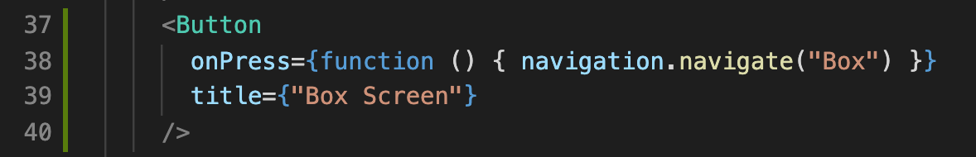
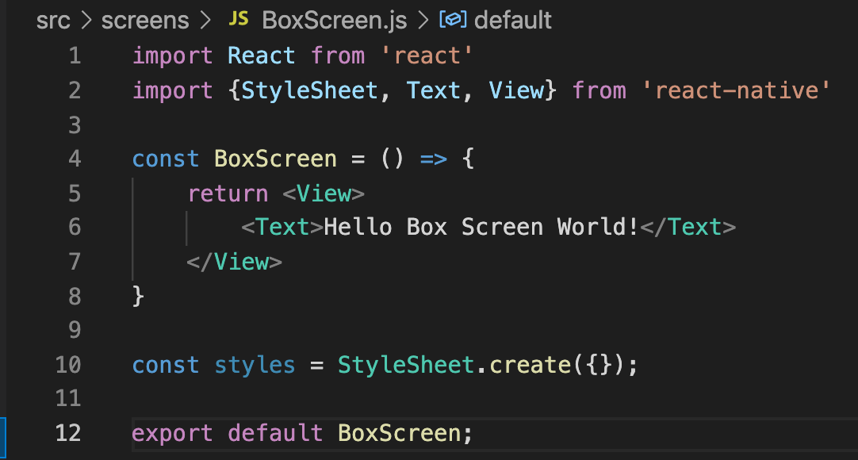
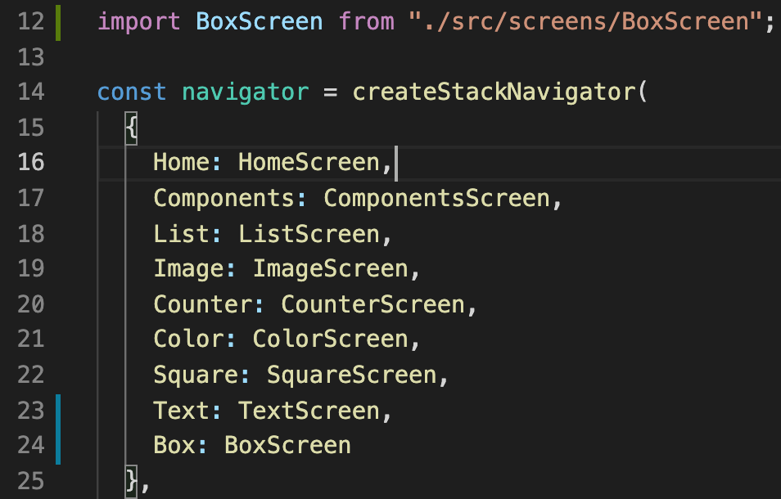
Today’s Plan
HomeScreen.js
Truly, we’ve become masters of this by now!
BoxScreen.js
App.js

Slide 15
Today’s Agenda
Today’s Plan
Intro to the Box Object Model
Intro to Flex Box
The Position Property
Putting it All Together

Slide 16
Box Object Model
OK! The Box Object Model!
As previously seen, this deals with the height and width of our components, and the amount of space around them.
Component 1
Component 2

Slide 17
Box Object Model
In order for this to make sense, you’ll first have to imagine that you have a piece of content.
Think of this as a placeholder for any type of element.
A <Text> component…
A <View> Component…
An <Image> Component.
Etc.
Content

Slide 18
Box Object Model
We’ve seen in this class, and it isn’t that hard to imagine, that we could draw a border around any given piece of content.
Like the border we drew around our TextInput component last time!
In this diagram down here, our content has a gigantic yellow border.
Border
Content

Slide 19
Box Object Model
Padding then, is the amount of space you want between your content and your border.
So here, we have our “content” in the center (think like <Text> or <TextInput> component.
There’s then going to be some “empty space” all around the content.
i.e., the padding. The more padding, the more space!
And then, after that, the border!
Border
Padding
Content

Slide 20
Box Object Model
And then, finally, the margin!
The margin, as previously discussed, is how much space there is between components!
Margin
Border
Padding
Content

Slide 21
Box Object Model
So, if you had two components next to each other…
Both with their own margin and borders and padding…
It might look something like this!
Margin
Margin
Border
Border
Padding
Padding
Content
Content

Slide 22
Box Object Model
We call each of these “things” layers.
i.e., the padding layer, the border layer, the margin layer.
By default in react native, our components will have a padding of 0, a border of 0, and a margin of 0.
i.e., it won’t have any of these layers to speak of!
Margin
Border
Padding
Content

Slide 23
Box Object Model
There are then various styling properties, that apply to different layers, or to different parts of these layers.
For example, we’ve seen and used backgroundColor. backgroundColor specifically changes the background color of the content and padding layers.
Margin
Border
Padding
For example,
if {backgroundColor: ‘black’}
Content

Slide 24
Box Object Model
You also don’t need to specify the size of a layer in its entirety.
Here are a set of style properties to specify the width of these layers “above” the content.
Margin
marginTop
Border
borderTopWidth
Padding
paddingTop
Content
height

Slide 25
Box Object Model
And as you might be able to intuit, there’s a corresponding set of properties for specifying the size of layers below the content as well.
Content
height
Padding
paddingBottom
Border
borderBottomWidth
Margin
marginBottom

Slide 26
Box Object Model
Here they are overlaid!
And as implied here, you can set all of these properties at once, giving them different values!
i.e., if you wanted to have a really huge martinTop, and a really small marginBottom…
Just give marginTop a big number, and marginBottom a small number!
Margin
marginTop
Border
borderTopWidth
Padding
paddingTop
Content
Content
height
height
Padding
paddingBottom
Border
borderBottomWidth
Margin
marginBottom

Slide 27
Box Object Model
And it’s not just top and bottom!
Here are the names of the properties to the left!
borderLeftWidth
marginLeft
paddingLeft
width
Content
Content

Slide 28
Box Object Model
And it’s not just top and bottom!
Here are the names of the properties to the left!
borderRightWidth
paddingRight
marginRight
width
Content

Slide 29
Box Object Model
And just in case it wasn’t clear:
These style properties, like marginTop and borderBottomWidth would all be defined in your stylesheet.
Though they could be defined inline as well!
Margin
marginTop
Border
borderTopWidth
Padding
paddingTop
Content
Content
height
height
Padding
paddingBottom
Border
borderBottomWidth
Margin
marginBottom

Slide 30
Box Object Model
By mixing and matching them, you can make lots of beautifully sized components!
Margin
marginTop
Border
borderTopWidth
Padding
paddingTop
Content
Content
height
height
borderLeftWidth
borderRightWidth
marginLeft
paddingRight
paddingLeft
marginRight
width
Padding
paddingBottom
Border
borderBottomWidth
Margin
marginBottom
Content
Content
Content

Slide 31
Box Object Model
There’s also all sorts of shortcut properties!
padding, margin, borderWidth: specify the padding, margin, or border width on all four sides.
marginVertical, paddingVertical: specify the margin or padding for ”top” and “bottom” at once.
marginHorizontal, paddingHorizontal: specify the margin or padding for “left” and “right” at once.
Margin
marginTop
Border
borderTopWidth
Padding
paddingTop
Content
Content
height
height
Padding
paddingBottom
Border
borderBottomWidth
Margin
marginBottom

Slide 32
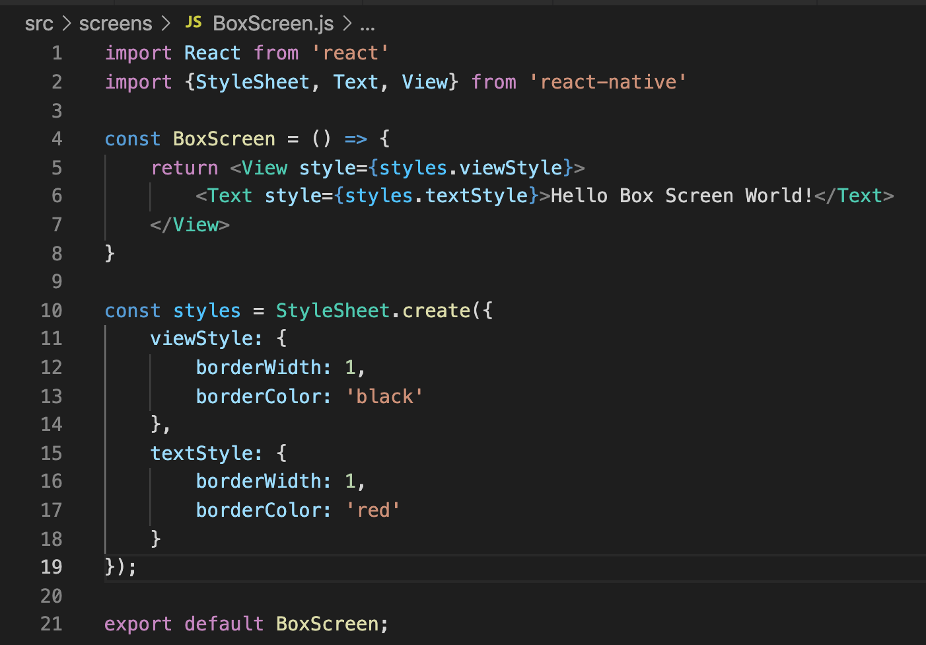
Box Object Model
Let’s begin playing around with these using code!
Here we update BoxScreen.js with some style information!

Slide 33


Box Object Model
Our stylesheet has two style objects!
One that we’ll give to our View component
The other we’ll give to our text component.

Slide 34
Box Object Model
And as we’ve seen, we need to set the style prop for our components, to know what styling information they should use!

Slide 35
Box Object Model
So, really fast...
What is this going to look like?

Slide 36
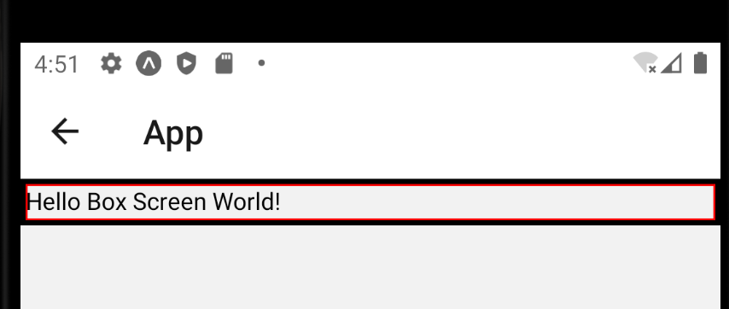
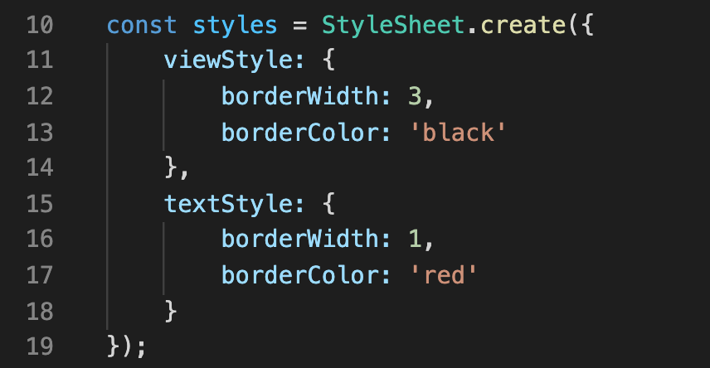
Box Object Model
Changing the value of borderWidth from 1 to 3 makes it bigger!
Note: the default ‘unit’ in react native are “domain independent pixels” or ”dips”.
A unit that will make components “look” about the same on all devices.

Slide 37
Box Object Model
So we can see that the red rectangle is right up against the black rectangle.
That’s because our Text component currently has 0 margin.
Also has 0 padding for that matter.
Let’s give it some vertical margin!

Slide 38
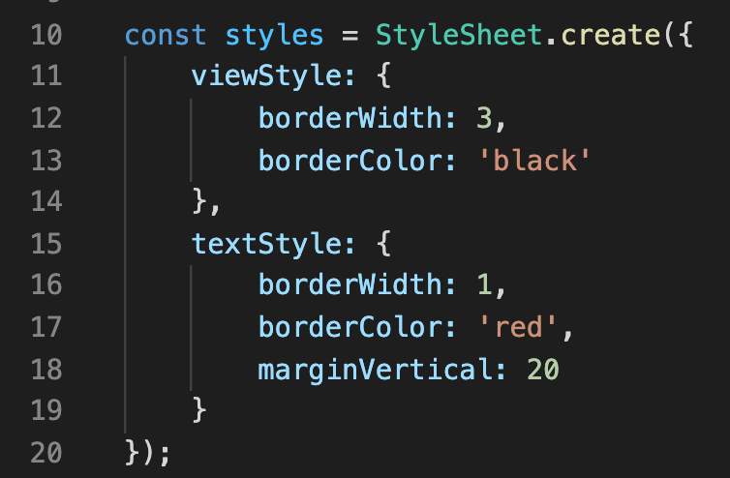
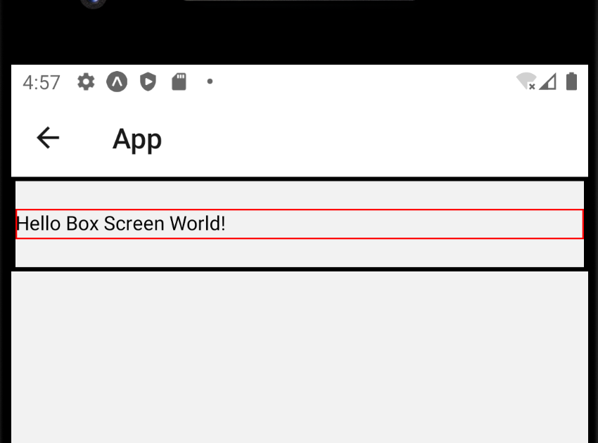
Box Object Model
When we give it some marginVertical, we would expect to see some extra space above and below our text component…
And indeed, that’s exactly what we get!

Slide 39
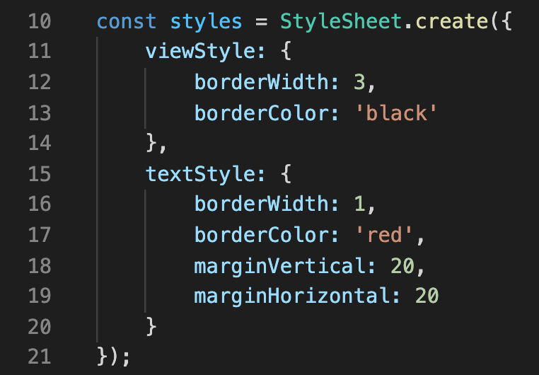
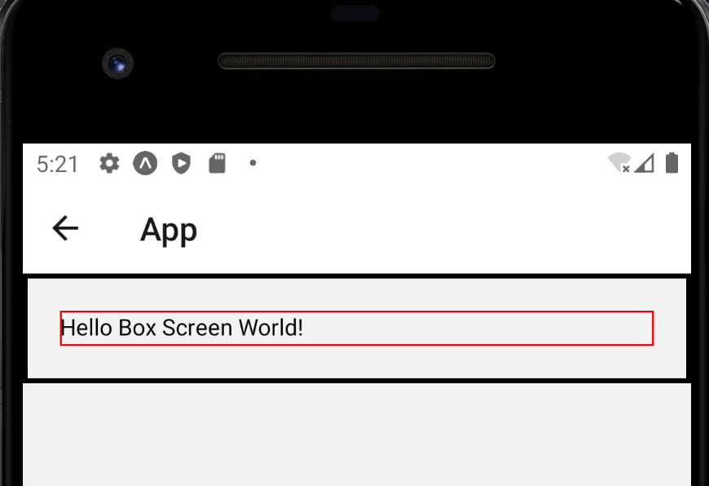
Box Object Model
And likewise, if we specify some marginHorizontal..
Now there is extra space to the left and right of our text component!
Now, of course, with THIS setup, we have all four sides covered, all with the same value…

Slide 40
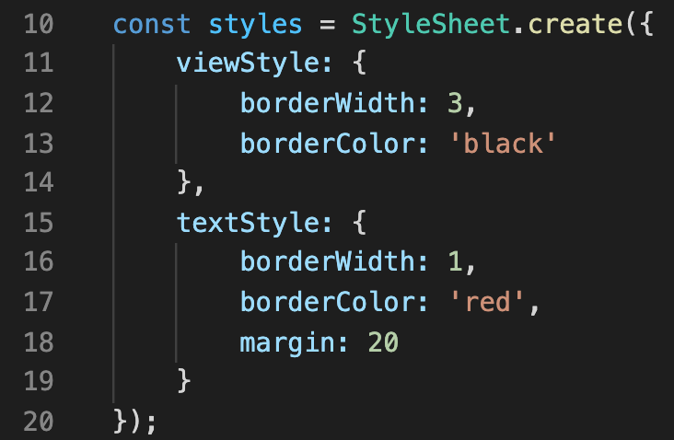
Box Object Model
So we could get away with just setting the value of margin, and it would have the exact same effect.
But you might be thinking that the text kinda bumps up against its border right now, right?
Let’s fix that with some padding!

Slide 41
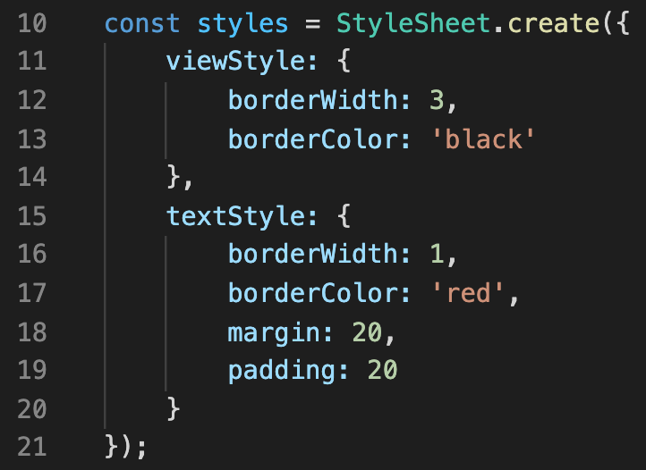
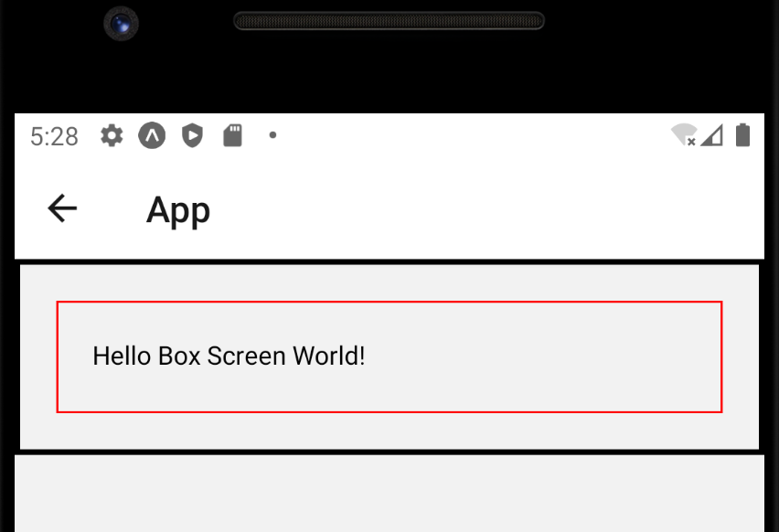
Box Object Model
Now that the text component has padding, it has more distance between its content and its border!
Which makes it a little easier to read!

Slide 42
Box Object Model
So, yeah, not too bad, right?
Adjusting the values of these style properties for a component isn’t *too* tricky, yeah?
Admittedly, it *does* get trickier once you are trying to create things that look a very specific way.
Which in order to do, you’ll typically have to combine these Box Object Model stuff along with the other layout systems we mentioned.
Margin
Border
Padding
Content

Slide 43
Today’s Agenda
Today’s Plan
Intro to the Box Object Model
Intro to Flex Box
The Position Property
Putting it All Together

Slide 44
Intro to Flex Box
So Flex Box, you might recall, was the one we said we wanted to use when you were specifying how “sibling” components should be positioned.
That is, when you have a bunch of components that all share the same parent.
Or in other words, all share the same container.
Parent Component
Child 1
Child 2
Child 3
Child 4

Slide 45
Intro to Flex Box
Just to combine a visual mock-up with some mock code…
Here, the “parent” component is the View.
i.e., the white box.
<View>
<Text>Child 1</Text>
<Text>Child 2</Text>
<Text>Child 3</Text>
</View>
Child 1
Child 2
Child 3
View

Slide 46
Intro to Flex Box
And that parent has three child components: our three Text components.
All of them nicely color coded and labelled.
Here, this diagram shows them arranged in the way that it’s worked by default: everything just kinda on top of each other.
<View>
<Text>Child 1</Text>
<Text>Child 2</Text>
<Text>Child 3</Text>
</View>
Child 1
Child 2
Child 3
View

Slide 47
Intro to Flex Box
So soon we’ll learn first-hand how to make it so that they DON’T need to always just be arranged in this way!
Using the power of Flex Box!
<View>
<Text>Child 1</Text>
<Text>Child 2</Text>
<Text>Child 3</Text>
</View>
Child 1
Child 2
Child 3
View

Slide 48
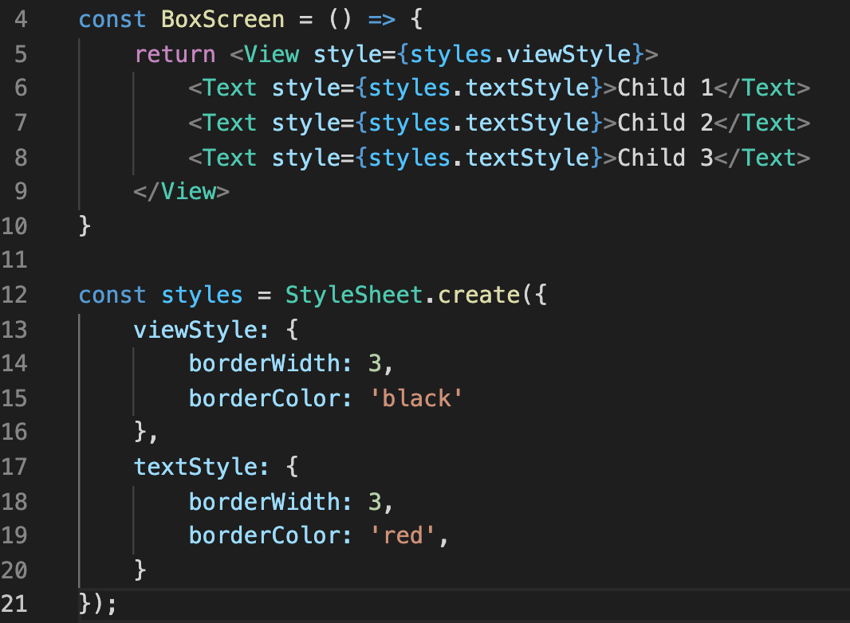
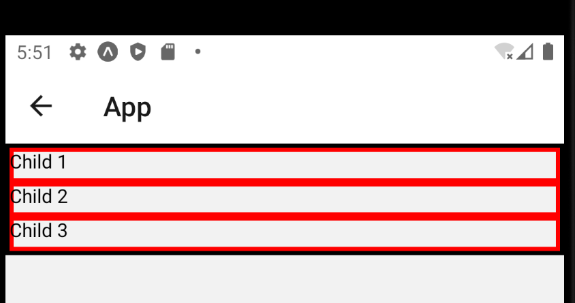
Intro to Flex Box
Let’s edit our same BoxScreen.js app to start kind of looking like that mock up.
We took away the margin and padding stuff.
Adding a couple more text components.
And changing their text to say child 1, 2, and 3.

Slide 49
Intro to Flex Box
So, even though we aren’t specifying anything Flex Box related yet…
There are still default values for those Flex Box properties in place.
Which is why we get the default layout behavior we see!

Slide 50
Intro to Flex Box
Child 1
The first property we will talk about is called alignItems
It is a property that gets tied to the parent component.
And affects how all of its children display.
alignItems has many different values it can take.
The default is “stretch”.
It makes the children use up as much horizontal space as possible.
Child 2
Child 3
View
alignItems: “stretch”
(applied to parent component)

Slide 51
Intro to Flex Box
Child 1
Child 2
Child 3
And so we can hopefully see the connection, yeah?
In our ”real app”, all three of our text components stretch all the way out across the screen!
Even though the “content” portion of the components only actually use a very small amount of space.
View
alignItems: “stretch”
(applied to parent component)

Slide 52
Intro to Flex Box
Child 1
An alternative value to alignItems is “flexStart”
This will have components only take up as much space as their content needs.
And arrange them along the “starting side” of the screen.
Fun fact: why “flexStart” and not “flexLeft”?
Child 2
Child 3
View
alignItems: “flexStart”
(applied to parent component)

Slide 53
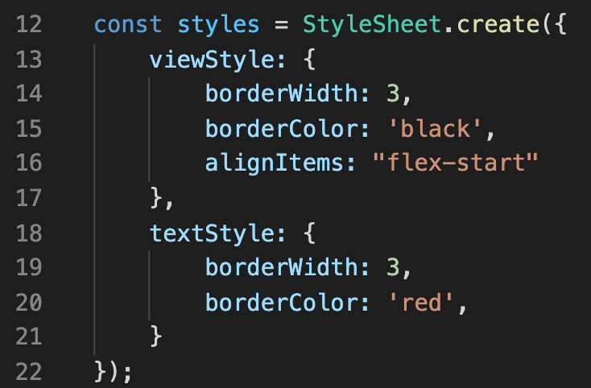
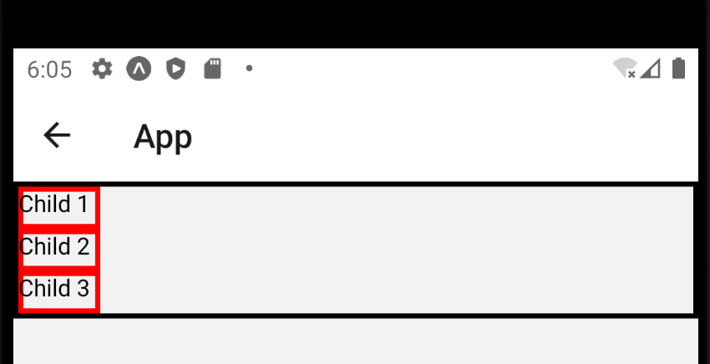
Intro to Flex Box
So now, when we apply the alignItems property with the “flex-start” value to the parent component…
You can see it has the effect we thought it might!
The size of the component is now much smaller! Only as big as it needs to be to fit its content!

Slide 54
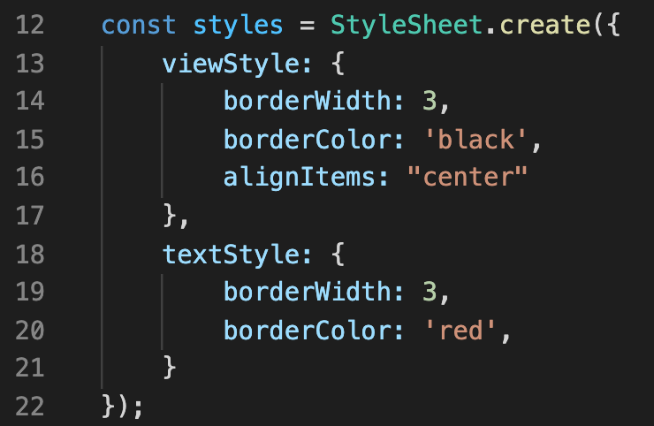
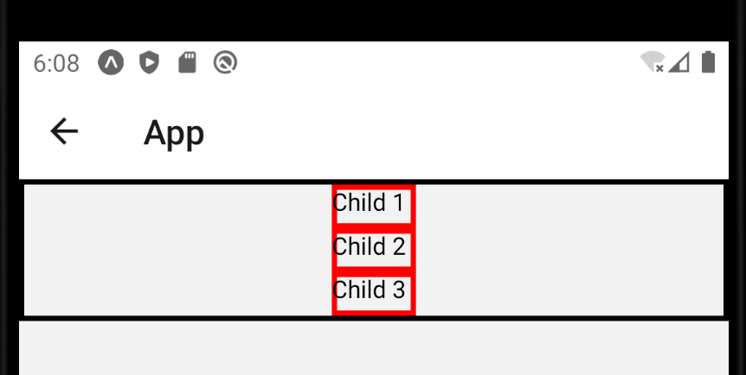
Intro to Flex Box
Another value for alignItems is “center”
Which also has the child elements only be of the width they need to fit their content…
But positions the children in the center of the parent.

Slide 55
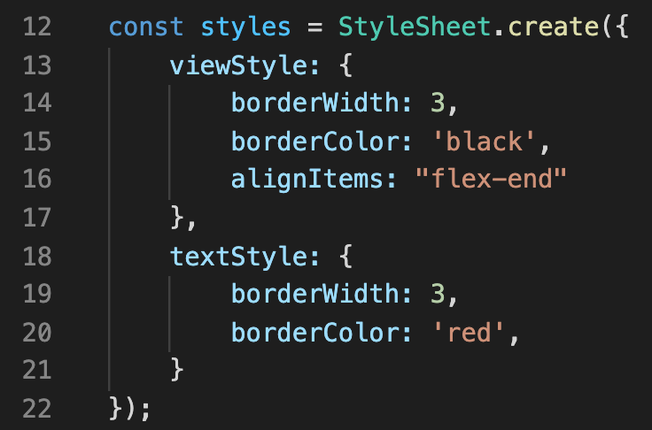
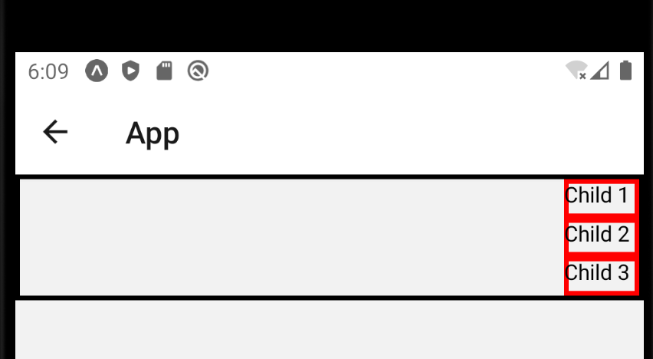
Intro to Flex Box
And finally, another value for alignItems is “flex-end”
Very similar to “flex-start” but, like, the opposite!
Everything is now at the “end” of the screen.
Which would be “right” for devices set to English.

Slide 56


Intro to Flex Box
Child 1
Child 2
Child 3
OK, lovely! alignItems is good stuff.
BUT! alignItems isn’t going to help us with the “everything stacks on top of each other” world we’ve been living in!
Can Flex Box help us escape this world? Can Flex Box help us have things go side by side instead?
View
Child 1
Child 2
Child 3
View

Slide 57
Intro to Flex Box
Child 1
Child 2
Child 3
Yes it can!
The secret is another property: flexDirection.
Once again, set on the parent component.
So here, the View.
Specifically assigned the value “row”
View
flexDirection: “row”
(applied to parent component)

Slide 58
Intro to Flex Box
Child 1
Child 2
flexDirection: “column”
(applied to parent component)
Child 3
This is in contrast to the default value of flexDirection, which is “column”
Which again, accounts for the default behavior we’ve been seeing.
View
Child 1
Child 2
Child 3
flexDirection: “row”
(applied to parent component)
View

Slide 59
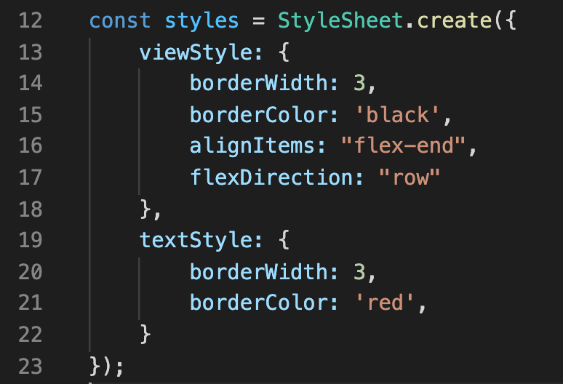
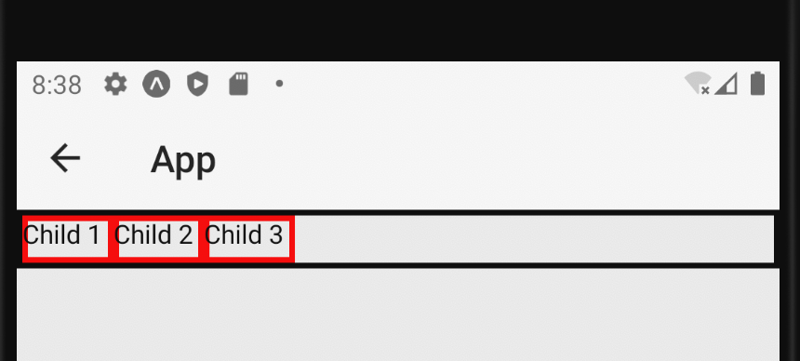
Intro to Flex Box
And you know, pics or it didn’t happen…
Here, our view now has flexDirection set to “row”
And indeed, all of the child elements now line up horizontally, instead of vertically.

Slide 60
Intro to Flex Box
So, hopefully that feels pretty good, but, ah, is there anything that *surprises* you on this slide…?
Given what we just talked about with alignItems and flexDirection…
Is this the output you would expect to see?

Slide 61
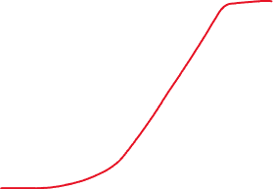

Intro to Flex Box
Here is where I imagine some of you might be surprised…
Our alignItems is set to “flex-end”
Which we just established should make our components show up on the right.
But our stuff *isn’t* showing up on the right, they are on the left!
What gives!?!

Slide 62
Intro to Flex Box
The reason why is that when we change flexDirection from “column” to “row”, we are changing the primary axis our content is using!
When flexDirection is “column”
New content we add is added vertically
And “alignItems” aligns that content horizontally.
When flexDirection is “row”
New content we add is added horizontally.
And “alignItems” aligns that content vertically.

Slide 63
Intro to Flex Box
Now, right now the View doesn’t have a height specified.
Which means that it is only as high as it needs to be to store its content.
i.e., the three text components.
Which means that we can’t really *see* that alignItems being set to “flex-end” is pushing the content to the bottom of the View.

Slide 64
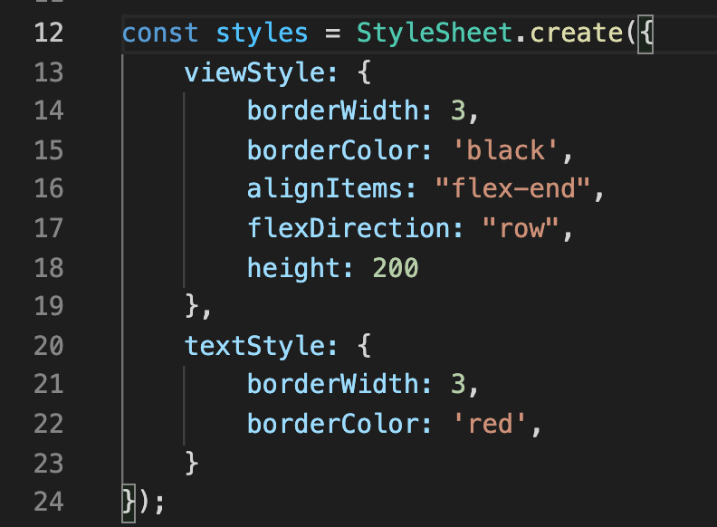
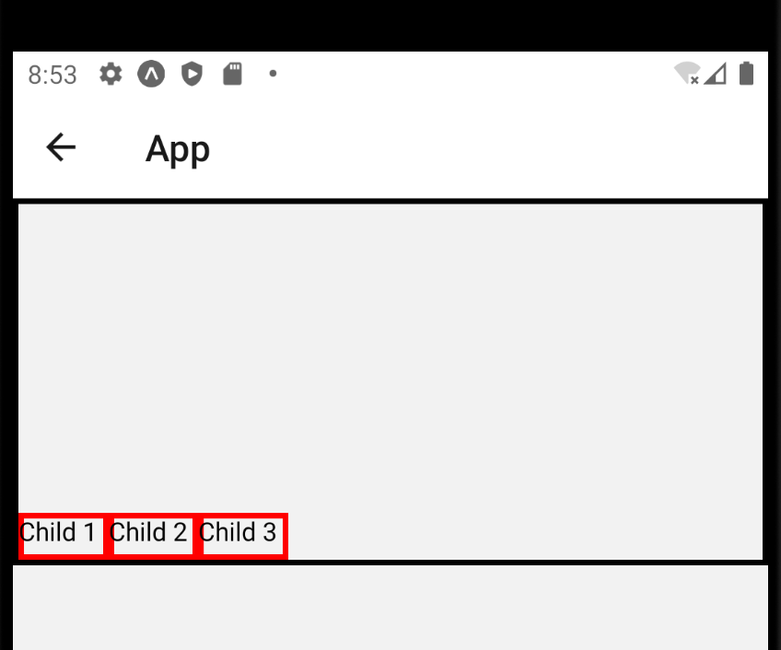
Intro to Flex Box
But we can force the View to have a big height.
Let’s say 200
And that now gives the text inside room to breathe!
And also helps us see all of those text elements get pushed up against the bottom!
Now thought experiment:
How will this screenshot change if we remove the “alignItems: “flex-end” line from the stylesheet?

Slide 65
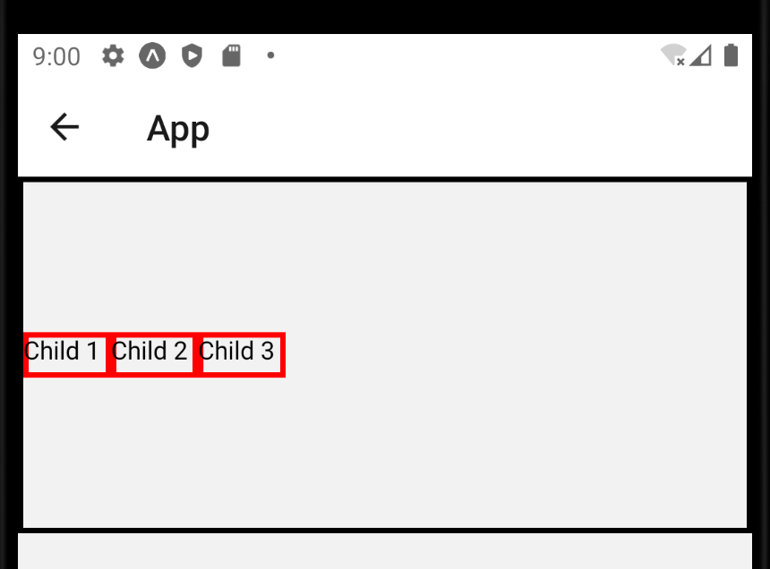
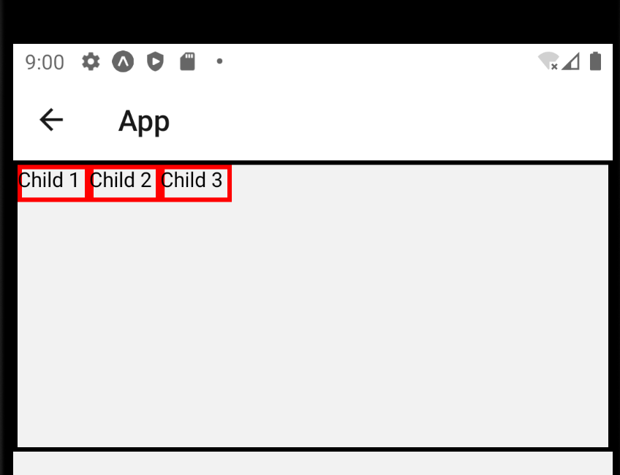
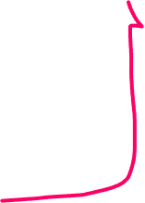

Intro to Flex Box
And then, just for completions sake, we can see it with the other values of alignItems we talked about.
Here, flexDirection is “row”, and alignItems is ”center”
And here, flexDirection is “row”, and alignItems is “flex-start”

Slide 66
Intro to Flex Box
OK! With alignItems and flexDirection, we can now do some pretty nice things regarding layout!
There’s yet another Flex Box property to share with you!
The justifyContent property.

Slide 67
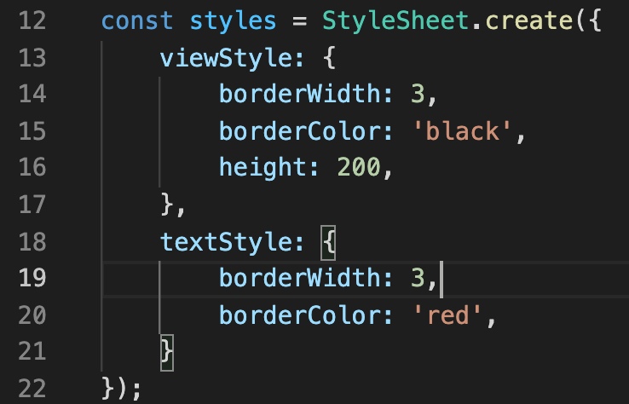
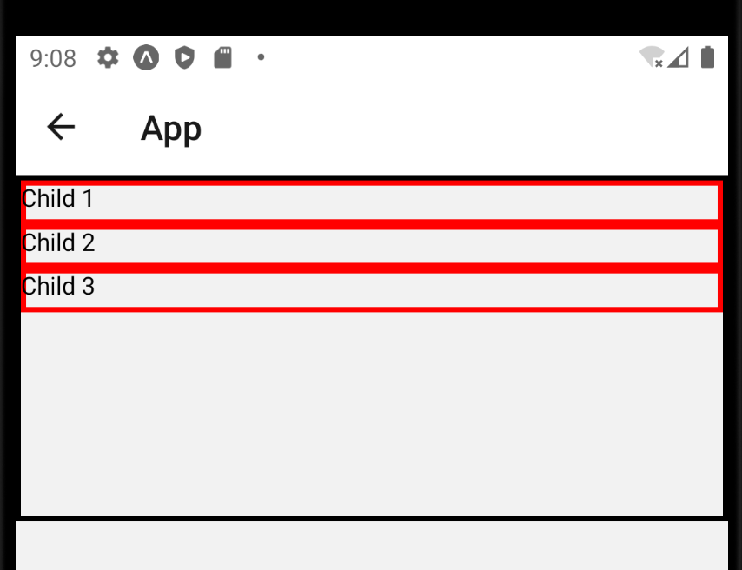
Intro to Flex Box
Real fast, let’s say we go back to this state.
So flexDirection is back to “column” by default.
And alignItems is back to “stretch” by default.

Slide 68
Intro to Flex Box
Child 1
So, at this moment, what if we WANTED something like this?
Where the child elements are stretched…
The children are vertically stacked on each other…
And the children are vertically centered in the parent?
Child 2
Child 3
View

Slide 69
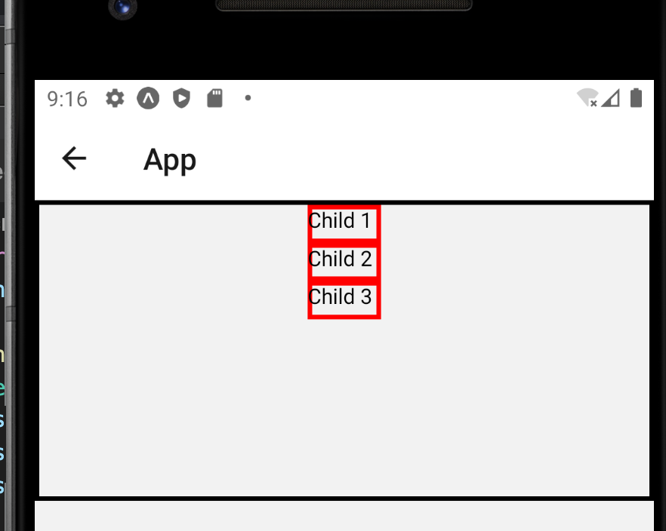
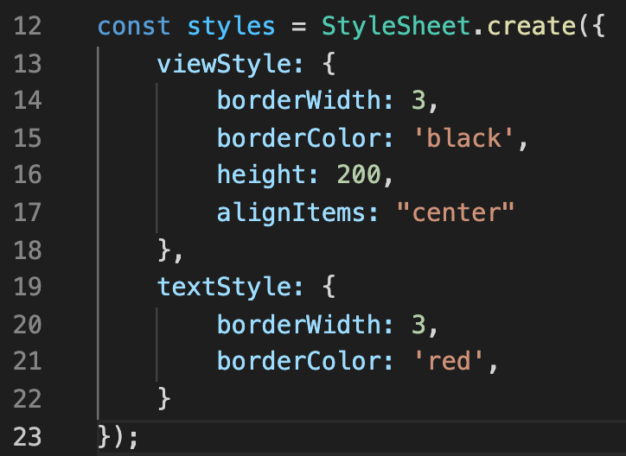
Intro to Flex Box
Child 1
Child 2
Sadly, alignItems: “center” won’t cut it here.
“center” is different from “stretched” so we lost that part of it.
And as we discussed, when the content is stacked vertically, alignItems will center horizontally.
Child 3
View

Slide 70
Intro to Flex Box
Child 1
Instead, we need to rely on our new friend: justifyContent
This centers content along the *same* primary axis.
i.e., if flexDirection is “column”, justifyContent will center vertically.
And if flexDirection is “row” justifyContent will center horizontally!
Child 2
Child 3
View
justifyContent: “center”
(applied to parent component)

Slide 71
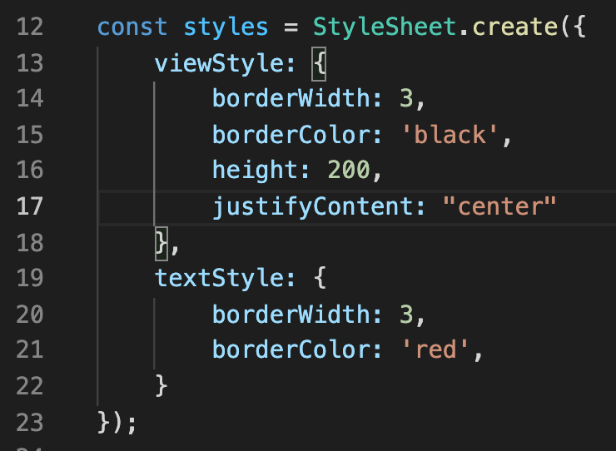
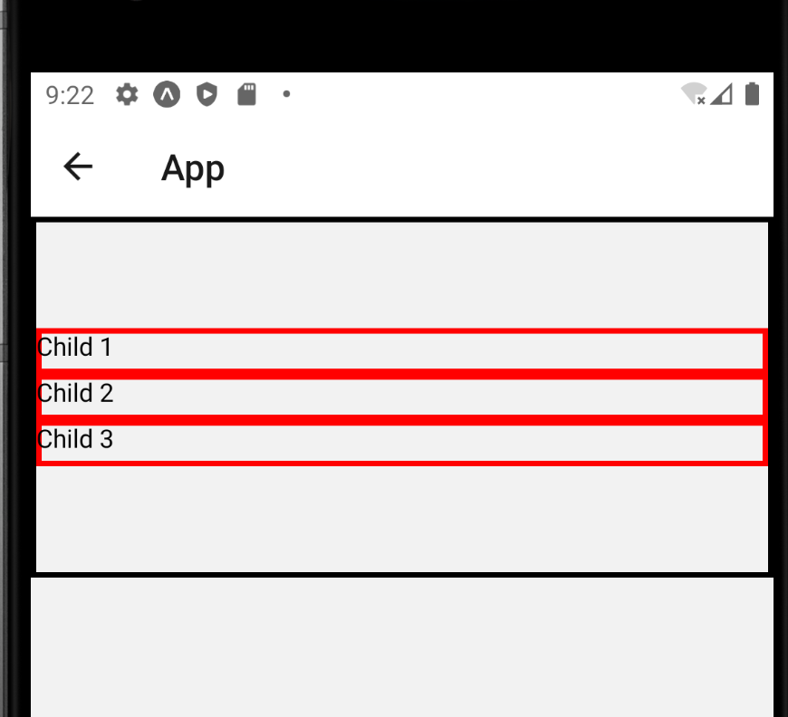
Intro to Flex Box
Like so!
We don’t specify flexDirection, so it defaults to “column”
We don’t specify alignItems, so it defaults to “stretch”
We *do* specify justifyContent to be “center”
And because we are in “column” mode, it centers our content vertically!

Slide 72
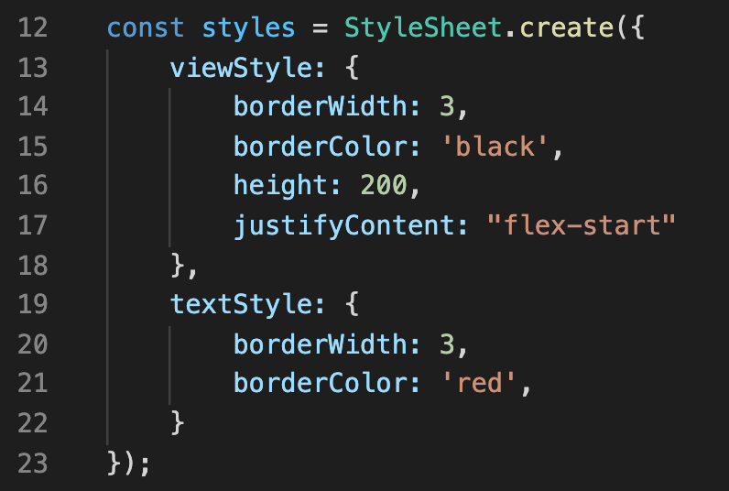
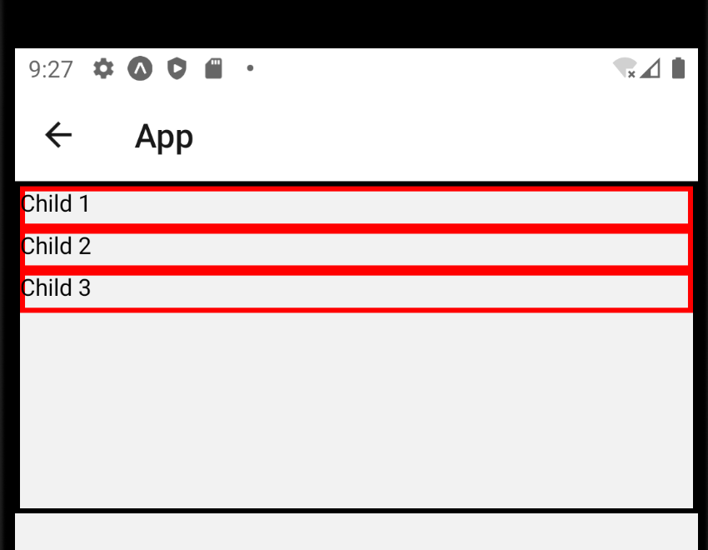
Intro to Flex Box
justifyContent also has a “flex-start” value…

Slide 73
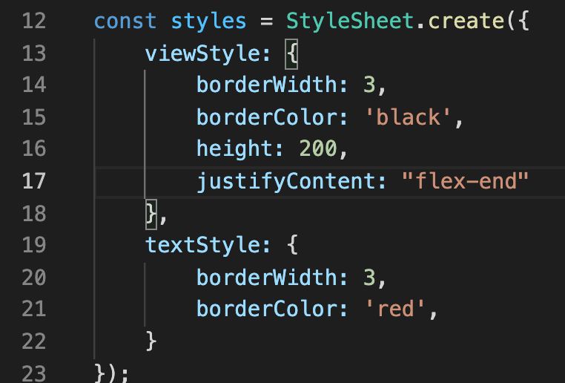
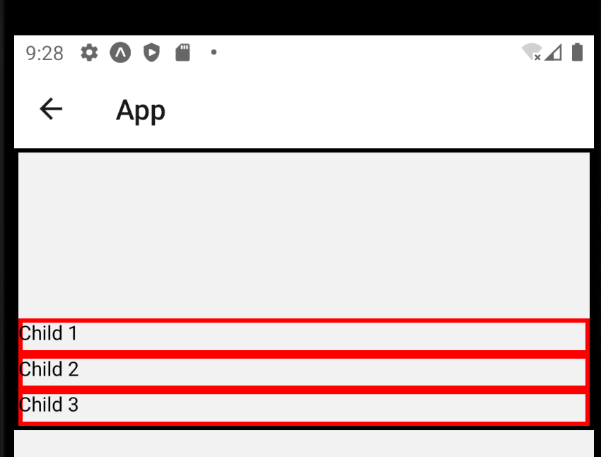
Intro to Flex Box
justifyContent also has a “flex-end” value…

Slide 74
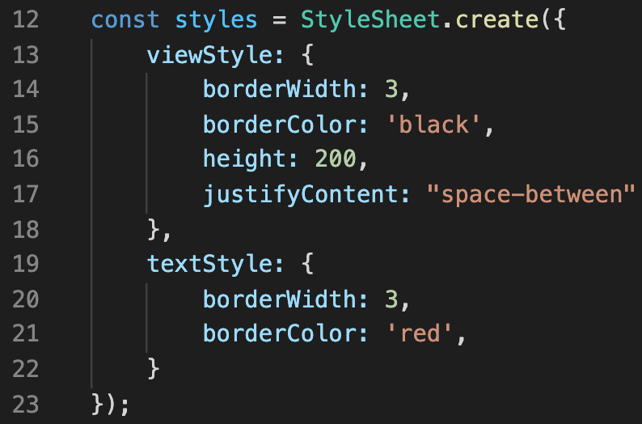
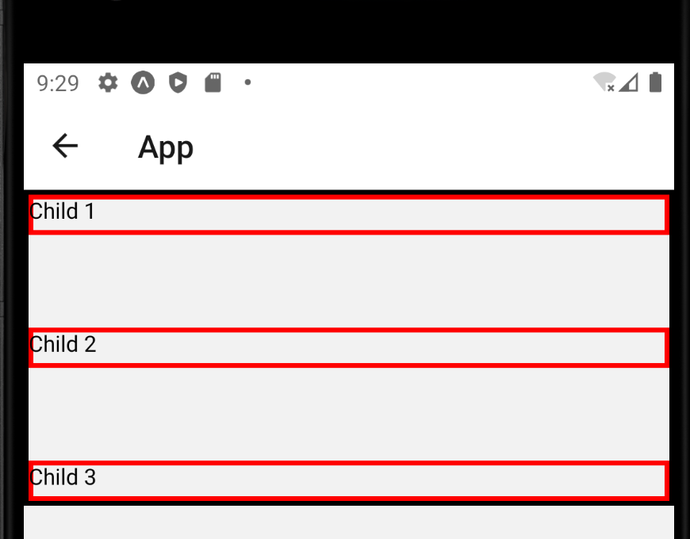
Intro to Flex Box
But it has some new ones too!
You can give justifyContent a “space-between” value…
Which creates evenly distributed space between all of the child elements!

Slide 75
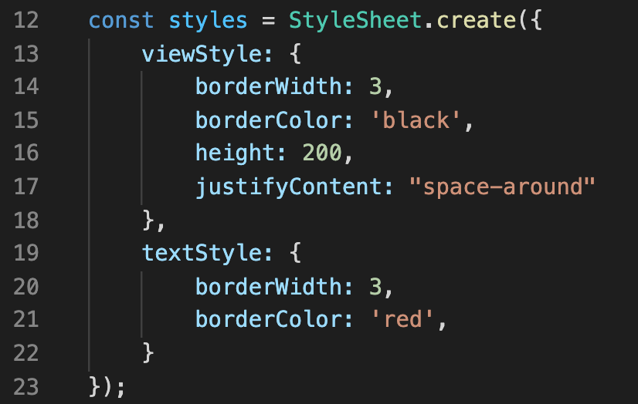
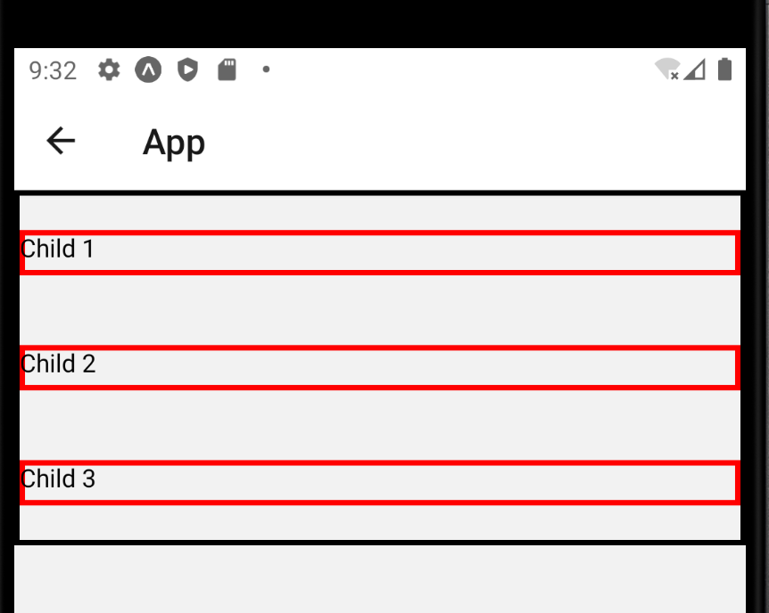
Intro to Flex Box
But it has some new ones too!
Or you can give justifyContent a “space-around” value…
Which is similar to “space-between”, but creates space both above and below the first and last elements as well.

Slide 76

Intro to Flex Box
And again, another little brain teaser…
Can you foresee what this would look like?
So flexDirection is “row”
And justifyContent is “space-around”
And “alignItems” is unspecified
And thus is “stretch” by default?

Slide 77

Intro to Flex Box
Maybe something like this!

Slide 78


Intro to Flex Box
And so if we wanted something centered both vertically AND horizontally…
We could set justifyContent to “center”, to center the content in the same axis as flexDirection…
Here horizontally, since we are dealing with “row”
And also set alignItems to “center”, to center the content in the other axis as flexDirectino.
Here vertically.

Slide 79
Intro to Flex Box
Neato! Our Flex Box knowledge is just getting better and better!
Remember: all of those properties we just chatted about get attached to the parent component.
But as we will discuss now, there are some Flex Box properties that we can specify for child components as well!

Slide 80
Intro to Flex Box
So, just to recap (and to glimpse into the future)…
Flex Box properties to attach to the parent component
alignItems
flexDirection
justifyContent
Flex Box properties to attach to a child component:
flex
alignSelf

Slide 81
Intro to Flex Box
Let’s start with the flex property.
The flex property gets assigned to a child…
…And it specifies how much space that child should try to take up within its parent.

Slide 82
Intro to Flex Box
Child 1
Child 2
So here, let’s say that child 2 has a flex property set to 1.
And child 1 and child 3 are left unspecified.
That will make child 2 take up more space than the other two children.
Child 3
flex: 1
(applied to child 2)

Slide 83
Intro to Flex Box
Child 1
Child 2
And perhaps should clarify: it will take extra space in the current flex axis.
So here, we see a “column” layout.
Which means that we are dealing with a vertical axis.
Which means that Child 2 is going to try to expand vertically.
Child 3
flex: 1
(applied to child 2)

Slide 84

Intro to Flex Box
Let’s see this “for real” – but now that we are giving properties to individual children…
Let’s expand our stylesheet to include specific styles for each Text element.

Slide 85

Intro to Flex Box
We’ll also go back to this version of the parent View component.
It should look like this.

Slide 86



Intro to Flex Box
And then, if we give child 2 a flex property of 1…
We should get something that looks like this!
Child 2 is hogging up a lot of space!

Slide 87


Intro to Flex Box
And if we change the parent back to using a flexDirection of “column”
We’ll get this!
Which, I confess, is closer to the mock up we just saw!
Now that we are in column mode, the child components are greedy for vertical space.

Slide 88


Intro to Flex Box
What if we gave two of these text elements a flex value of 1?
Now, both child 2 and child 3 will try to expand to fill the space!
But they will share it! So they should be of the same size.

Slide 89


Intro to Flex Box
What if *all* of them had a value of 1?
Then again, they take up all available space, and share it equally!

Slide 90
Intro to Flex Box
So, here’s the thing about these Flex values.
You can basically give them any number…
And the amount of space any given item gets is proportional to the total Flex specified.

Slide 91


Intro to Flex Box
Take this one for instance.
Both child1 and child2 have a flex of 4.
And child 3 has a flex of 2.

Slide 92
Intro to Flex Box
That means that the total “amount” of Flex is 10.
4+4+2 = 10
So the proportion of space that child 1 gets is 4/10 (here, 40%)
That’s “my flex” / “total flex”
Same with child 2
Child 3 gets 2/10, so only 20%

Slide 93
Intro to Flex Box
Great, so that’s the Flex property!
There’s now one more Flex Box property we’re going to chat about today.
It is another one that you apply directly to child elements.
And that is the alignSelf property.

Slide 94
Intro to Flex Box
Child 1
The basic premise of alignSelf is that it is a way for a child element to override the “alignItems” property of its parent!
So we’ve seen this a few times before!
Child 2
Child 3
View
alignItems: “stretch”
(applied to parent component)

Slide 95
Intro to Flex Box
Child 1
But check this out!
If the parent component has alignItems set to stretch…
…but a child (say, child 2) component has alignSelf to something else…
Then the child will strike out on its own! What a rebel!
Child 2
Child 3
View
alignItems: “stretch”
(applied to parent component)
alignSelf: ”flex-end” on child 2

Slide 96
Intro to Flex Box
You can use the same values for alignSelf as you can for alignItems.
Child 1
Child 1
Child 1
Child 2
Child 2
Child 2
Child 3
Child 3
Child 3
View
View
View
alignItems: “stretch”
(applied to parent component)
alignSelf: ”flex-start” on
child 2
alignItems: “stretch”
(applied to parent component)
alignSelf: ”center” on child 2
alignItems: “stretch”
(applied to parent component)
alignSelf: ”flex-end”
on child 2

Slide 97


Intro to Flex Box
And we can see this with actual code as well!
As you can see, our second child has an alignSelf value of ‘flex-start’
And that made it break away from its pack!

Slide 98


Intro to Flex Box
And here it is with alignSelf having a value of center…

Slide 99


Intro to Flex Box
And finally, one last one with flex-end

Slide 100


Intro to Flex Box
And maybe it goes without saying, but this overriding behavior still happens when the parent component has an alignItems explicitly set.

Slide 101
Today’s Agenda
Today’s Plan
Intro to the Box Object Model
Intro to Flex Box
The Position Property
Putting it All Together

Slide 102
The Position Property
OK, not bad!
We’ve learned about the Box Object Model!
We’ve also learned a bunch about Flex Box!
Let’s chat about our third layout system: the position property.
This is another way to get child components to “do their own thing”

Slide 103
The Position Property
Child 1
position is a styling property that has many values.
The default value is “relative”
It means “behave as normal”
All of the previous examples assumed components had a position property of ”relative”
Child 2
Child 3
View
position: “relative”
(applied to Child 2)

Slide 104
The Position Property
Child 1
Child 2
A more exciting value for the position property is “absolute.”
Look at it hiding in the corner now!
It made the component get ignored by its siblings.
Though it looks like it is now off in no-man’s-land, there *are* still some flex box rules it will obey if set to its parent.
Child 3
View
position: “absolute”
(applied to Child 2)

Slide 105


The Position Property
Our first example of this!
It might be hard to tell here, but right now, child 1 and child 2 are being drawn directly on top of each other.

Slide 106


The Position Property
It certainly doesn’t look “better” per se…
But by increasing the font size of child2, we can (kinda) more clearly see that they are on top of each other.

Slide 107
The Position Property
And we can take a moment to appreciate that, as rebellious as child 2 is, it is still obeying the “alignItems: center” style on its parent!

Slide 108


The Position Property
But that’s not the case for every value of alignItems!
If we set it to stretch, child 1 and child 3 stretch out obediently.
But not so child 2!

Slide 109
The Position Property
So, when something has a value of “absolute” for their position property…
We can see that they kind of get ignored by/ignore their own siblings.
But their parent can---at times---still exert influence over it that it listens to.
Just like some families in real life.

Slide 110
The Position Property
Let’s move on to another aspect of Position…
It is four new properties that are connected to position:
top
bottom
left
right

Slide 111
The Position Property
These properties are going to *feel* and *look* pretty similar to setting the margin of a component!
But they behave slightly differently!
Let us once again look at this mock up!
Child 1
Child 2
Child 3
View

Slide 112
The Position Property
Here is us applying the top property to Child 2, with a value of 10.
It gives is 10 “dips” of distance along its top.
Similar to margin!
But how it *achieves* this is actually kind of different!
Child 1
10
Child 2
Child 3
View
top: 10
(applied to Child 2)

Slide 113
The Position Property
The way that “top” works is that at first, it renders everything ”normally”
So here, we have this situation, where we have all three children, stacked on top of each other
(So the flexDirection must be set to column, or is just using the default).
Child 1
Child 2
Child 3
View
top: 10
(applied to Child 2)

Slide 114
The Position Property
And it is then, AFTER everything has been rendered, that the top property gets applied.
So yeah, child 2 earned itself 10 extra “units” of space along the top…
But it got that by shifting downwards, on top of Child 3!
So Child 3 here kind of “lost” 10 units of space as a result of this.
Child 1
10
Child 2
10
Child 3
View
top: 10
(applied to Child 2)

Slide 115
The Position Property
Let’s move on to bottom – it is very similar.
Here, Child 2 has been given a bottom value of 10.
The process begins in the same way: all of the child components are arranged “normally”…
Child 1
Child 2
Child 3
View
bottom: 10
(applied to Child 2)

Slide 116
The Position Property
And then Child 2 is given some extra space along the bottom by getting shifted upwards.
So in this world, Child 2 is now “resting” on top of Child 1 a little bit.
Child 1
10
Child 2
10
Child 3
View
bottom: 10
(applied to Child 2)

Slide 117
The Position Property
The left and right properties are also similar.
The difference is that instead of being shifted on top of another component, they can be shifted outside of the screen entirely!
Let’s start with left – if a value of 10 is applied to child 2, what do you think will happen?
Child 1
Child 2
Child 3
View
left: 10
(applied to Child 2)

Slide 118
The Position Property
It will, once again, give it some space to the left!
But as promised: now the right hand side of the component is “off screen” – we won’t see the whole thing any more!
Child 1
10
Child 2
Child 3
View
left: 10
(applied to Child 2)

Slide 119
The Position Property
And some with the right property, yeah?
Now it is getting pushed off the side to the left!
Child 1
10
Child 2
Child 3
View
right: 10
(applied to Child 2)

Slide 120


The Position Property
I think the mock-ups do a pretty good job of conveying the idea…
But we can reinforce it with some code, too!

Slide 121
The Position Property
Here, text 2 has a ‘top’ property!
That causes it to shift down 10 units from its top edge.
And in so doing, overlap a little bit with Child 3.

Slide 122


The Position Property
And indeed, changing top to bottom has the effect we would think!
It’s now shifted up 10 units from its bottom edge.
Causing it to overlap with Child 1.

Slide 123


The Position Property
Here it is with left!
Shifts it 10 units from its left-hand edge.
Might be hard to see, but the right hand side of child 2 is now off the screen.
Extends past its parent component!

Slide 124


The Position Property
And just to complete the set, here is right.
You can see it gets shifted 10 units from its right edge.
Which causes the left hand side to get pushed outside its container!

Slide 125
The Position Property
Nice!
Now, I know that *I* get ‘top’ and ‘bottom’ and ‘marginTop’ and ‘marginBottom’ mixed up sometimes!
E.g., I’ll use top when I actually wanted marginTop
So, ah just something to be aware of!

Slide 126
The Position Property
OK – shifting gears a *little*
But still mostly the same.
A thing that we’ll find helpful to us is having an easy way to make a child component fill up the available space of its parent.
Child 1
Child 2
Child 3
View

Slide 127
The Position Property
That is to say, if want Child 2 to use up all possible available space, it would end up looking like this:!
The parent component is still there! The View hasn’t gone away.
It is just being entirely used up by this one particular child.
Child 1
Child 2
Child 3
View

Slide 128
The Position Property
In order to achieve that, there are a couple of things we need to do.
The first is we need to give Child 2 a position value of “absolute”
Child 1
Child 2
Child 3
View
position: “absolute”
(applied to Child 2)

Slide 129
The Position Property
That change alone would have an effect like this, yeah?
It makes the child ignore / be ignored by its siblings.
And would also make it ignore certain “alignItems” values of the parent component, for that matter.
Child 1
Child 2
Child 3
View
position: “absolute”
(applied to Child 2)

Slide 130
The Position Property
Now here’s where the trick comes in…
We just saw that when you specify left or right, it shifts away from that edge by that many pixels.
What will happen if we set BOTH left AND right to 0?
Child 1
Child 2
Child 3
View
position: “absolute”,
left: 0,
right: 0
(applied to Child 2)

Slide 131

The Position Property
The left:0 part of it makes it want to be right up against the left edge…
And the right:0 part of it makes it want to be directly against the right edge.
So you would end up getting something like what we’re seeing here!
Basically simulating the stretch effect!
Child 1
Child 2
Child 3
View
position: “absolute”,
left: 0,
right: 0
(applied to Child 2)

Slide 132
The Position Property
Likewise, if we added top: 0 and bottom: 0
It now wants to be 0 pixels shifted away from the top…
And 0 pixels shifted away from the bottom.
Child 1
Child 2
Child 3
View
position: “absolute”,
left: 0,
right: 0,
top: 0,
bottom: 0
(applied to Child 2)

Slide 133
The Position Property
So that’s the trick!
If you want a child component to ever use up all of the available space of the parent…
You set the child component’s position attribute to “absolute”
And you set left, right, top, and bottom all to 0.
Child 1
Child 2
Child 3
View
position: “absolute”,
left: 0,
right: 0,
top: 0,
bottom: 0
(applied to Child 2)

Slide 134



The Position Property
And if we do that in code…
Setting the position property as well as the four directions.
We can see that indeed, Child 2 now uses up all of the available space of the parent!
Evidenced by the red border around the whole screen.

Slide 135


The Position Property
As it turns out, this is so commonly needed, that React Native provides a short hand way of specifying those five properties.
Those five properties are stored in StyleSheet.absoluteFillObject.
So you add those to your style object using that same … syntax we’ve seen before.
Basically: copy and paste the things from this OTHER object into this new object that I’m making here.

Slide 136
The Position Property
Doing it that way will make it end up having the exact same effect as if you specified them all by hand.

Slide 137
Today’s Agenda
Today’s Plan
Intro to the Box Object Model
Intro to Flex Box
The Position Property
Putting it All Together

Slide 138
Putting It All Together
So, fantastic!
By this point, we’ve got a lot of tools under our belts for arranging things nicely and making our screen layouts look good!
BUT..

Slide 139
Putting It All Together
To get to this point, there’s been a whole lot of special edge cases, right?
Like with position: absolute vs. top: 10
With just setting something to position: absolute, the other siblings sorted themselves out…
But when we set a sibling’s top value to 10, then there was weird overlapping that was happening, and things *didn’t* re-arrange themselves!

Slide 140
Putting It All Together
Apply box object model rules
Is position ‘absolute’?
Here is a little flow chart that might help you out as you think about this in the future!
Yes
No
Apply *all* flex box rules, considering siblings
Apply *some* flex box rules, ignore all siblings
Place element inside of parent.
Apply top, left, right, bottom
Apply top, left, right, and bottom.

Slide 141
Putting It All Together
Apply box object model rules
Is position ‘absolute’?
So, no matter what, we take a component and apply the box object model rules.
So, this is includes things like…
padding
margin
border
Yes
No
Apply *all* flex box rules, considering siblings
Apply *some* flex box rules, ignore all siblings
Place element inside of parent.
Apply top, left, right, bottom
Apply top, left, right, and bottom.

Slide 142
Putting It All Together
Apply box object model rules
Is position ‘absolute’?
We then look at the position property – and we check too see if it is ”absolute” or “relative”
No
Yes
Apply *all* flex box rules, considering siblings
Apply *some* flex box rules, ignore all siblings
Place element inside of parent.
Apply top, left, right, bottom
Apply top, left, right, and bottom.

Slide 143
Putting It All Together
Apply box object model rules
Is position ‘absolute’?
If the position IS absolute, we look at SOME flex box rules to determine where the element should be displayed.
i.e., some values of alignItems and justifyContent
But the sibligns get totally ignored.
i.e., things can overlap each other.
No
Yes
Apply *all* flex box rules, considering siblings
Apply *some* flex box rules, ignore all siblings
Place element inside of parent.
Apply top, left, right, bottom
Apply top, left, right, and bottom.

Slide 144
Putting It All Together
Apply box object model rules
Is position ‘absolute’?
Then after it is “placed correctly” based on the above, we then apply top, left, right, and bottom.
I.e., shifting it away a certain amount in the specified directions.
No
Yes
Apply *all* flex box rules, considering siblings
Apply *some* flex box rules, ignore all siblings
Place element inside of parent.
Apply top, left, right, bottom
Apply top, left, right, and bottom.

Slide 145
Putting It All Together
Apply box object model rules
Is position ‘absolute’?
If instead, the position was “relative” (and NOT absolute”
Then *all* flex box rules from the parent (and itself) apply.
And siblings are considered (i.e., it’s still in the flow of the rest of the content).
No
Yes
Apply *all* flex box rules, considering siblings
Apply *some* flex box rules, ignore all siblings
Place element inside of parent.
Apply top, left, right, bottom
Apply top, left, right, and bottom.

Slide 146
Putting It All Together
Apply box object model rules
Is position ‘absolute’?
It is then placed inside of the parent, nicely oriented with the other siblings.
And then finally top, left, right, and bottom are applied.
So even in “relative” land, it is possible for things to overlap each other.
No
Yes
Apply *all* flex box rules, considering siblings
Apply *some* flex box rules, ignore all siblings
Place element inside of parent.
Apply top, left, right, bottom
Apply top, left, right, and bottom.

Slide 147
Putting It All Together
Apply box object model rules
Is position ‘absolute’?
So hopefully this gives you a good idea about the order in which these different layout systems get applied in!
No
Yes
Apply *all* flex box rules, considering siblings
Apply *some* flex box rules, ignore all siblings
Place element inside of parent.
Apply top, left, right, bottom
Apply top, left, right, and bottom.

Slide 148
Putting It All Together
A final challenge!
Imagine this set up to the right – where you have two elements that are “along the top” and one element that is a little lower down.
They can be Text components, or Views, or whatever!
Child 1
Child 3
Child 2
View

Slide 149
Putting It All Together
Your challenge is to recreate this setup in at least TWO different ways!
The beautiful thing about these layouts is that there’s basically never only one way to achieve a certain effect!
So see how many ways you can achieve this! Go for it!
Child 1
Child 3
Child 2
View

